Slide 1
ECS 101 Final Project
Coin-Flipping Game
Qiyao Chen, Jiajie Lin, Natalie Huang, Laurel Howell

Slide 2
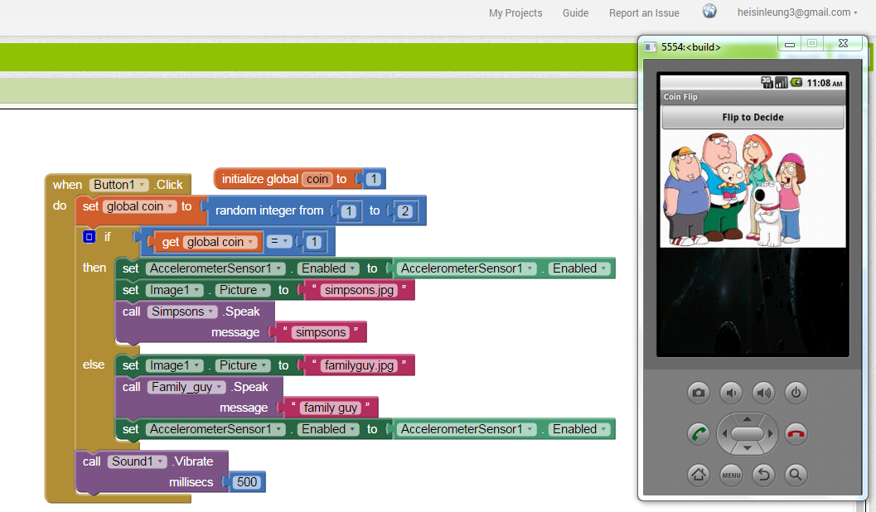
Coin-Flip
This is what normal people do
This is what students do after taking computer class

Slide 3
Introduction
Conditions:
144 turns
Score 1 or more points to win
Quarter= +2/-2, Dime=+1/-1 (Unit : Point)
144 turns and minimum score of -100, maximum score for quarter is 100 and maximum score for dime is 50 . (Columns for turns) (Rows for scores)
Apply the algorithms we have to simulate the highest possible chance to win the game

Slide 4
Algorithms
Dime : 0.5 * f (s-1,t-1) + 0.5 * f (s+1,t-1)
Quarter : 0.5 * f (s-2,t-1) + 0.5 * f (s+2,t-1)
Max{0.5 * f (s-1,t-1) + 0.5 * f (s+1,t-1), 0.5 * f (s-2,t-1)+0.5 * f (s+2,t-1)}

Slide 5
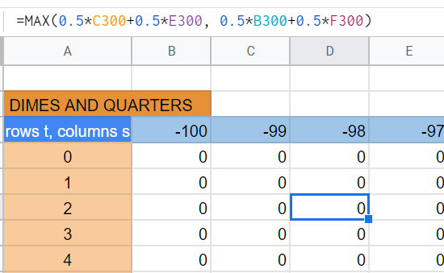
Applying the Algorithm
Dimes algorithm
Quarter algorithm

Slide 6
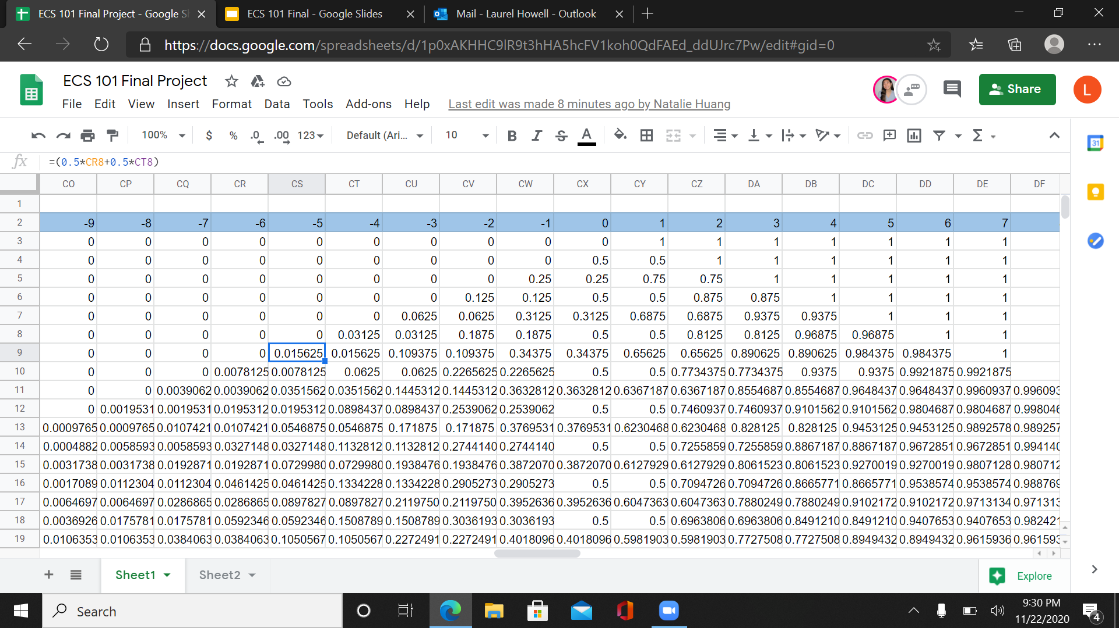
Probability
Represents the likelihood of winning (percentage) if you choose to flip a dime or quarter with that specific score and amount of turns left.
For example: In cell CS9, you can see that you have a score of -5 and 9 turns left. If you were to flip ONLY a dime in this instance, it would give you a 0.015625 or a 1.56% chance of winning.

Slide 7
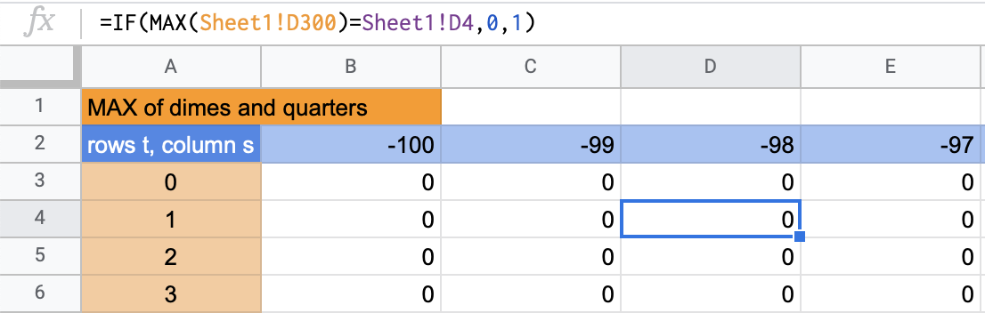
Which Coin to Flip?
Dime
Quarter
**If the probability of flipping a dime and quarter are equal, Excel will display a “0”, but either coin would work**

Slide 8
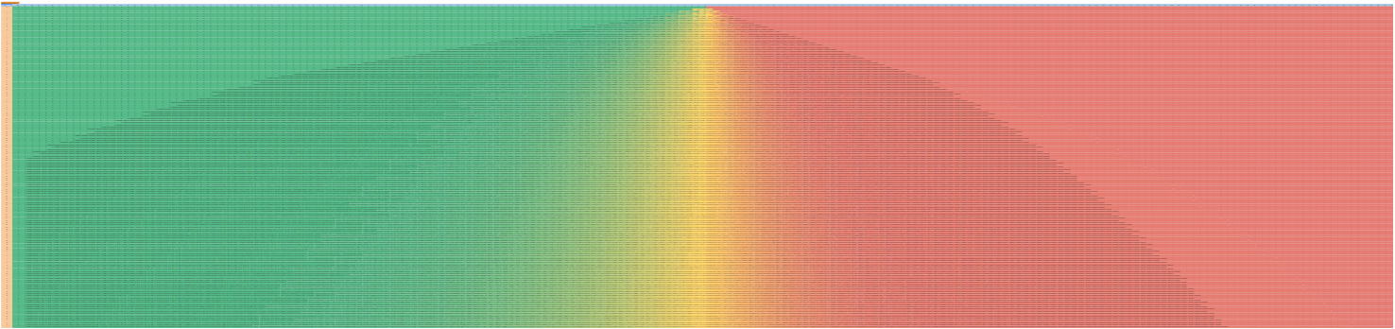
Graphics
Dimes and Quarter

Slide 9
The End
Thank you!
Any Questions?

Slide 10
Citations
Coin Flip by Krishanpal Singh in 2020 | Animation design, Motion design, Coins (pinterest.com)
Coin Flip Stimulation Projects - Hei Sin Leung's Computer Science (google.com)
Redirect Notice. (n.d.). Retrieved November 22, 2020, from https://www.google.com/url?sa=i

